Slide 1

Biomolecular simulations with AMOEBA
Richard Bradshaw, Noor Mohamed & Frank Longford
University of Southampton, 09-Dec-16
Please log in and load up the website:
https://sites.google.com/site/amoebaworkshop

Slide 2
Welcome!
Today’s timeline:
Time | Topic
9.30 - 10.00 | Arrival & setup
10.00 - 10.20 | An introduction to AMOEBA
10.20 - 11.20 | Exercise 1
11.20 - 11.40 | Coffee break
11.40 - 12.30 | Exercise 2
12.30 - 13.30 | Lunch
13.30 - 15.00 | Exercise 2 (cont.)
15.00 - 15.20 | Coffee break
15.20 - 16.30 | Exercise 3
16.30 - 17.00 | Wrap up & research talk
17.00 | Departure/Q&A

Slide 3

Housekeeping
You are here (R2143)
Café
Main entrance

Slide 4
Atomistic force fields
1994
1999
2006
2010
2015
The underlying potential energy function hasn’t really changed:
Bonds
Angles
Torsions
(inc. impropers)
van der Waals
Electrostatics
And we still (sometimes) get things wrong…

Slide 5
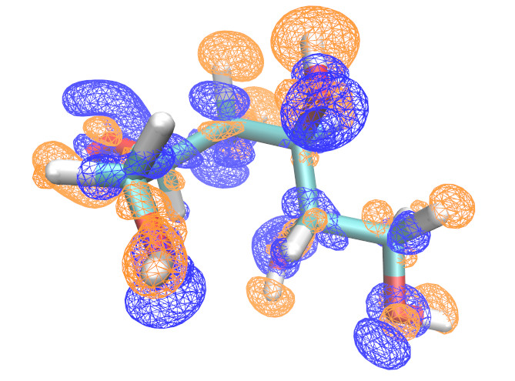
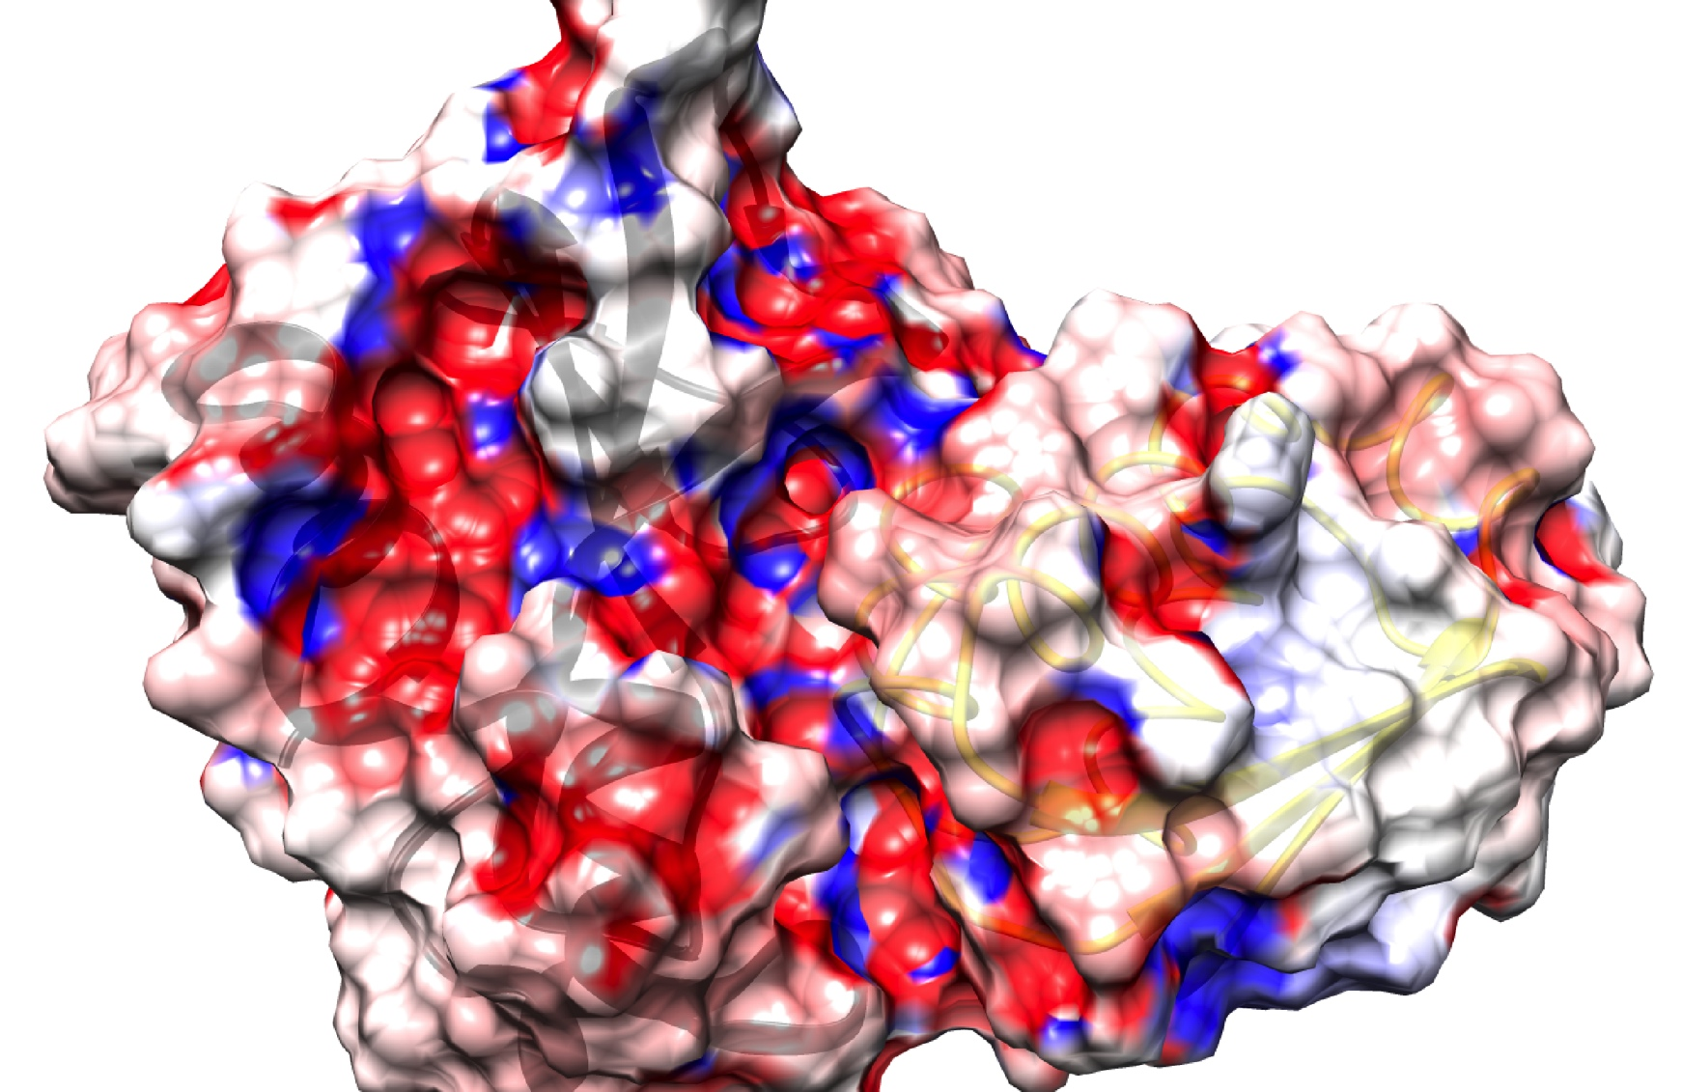
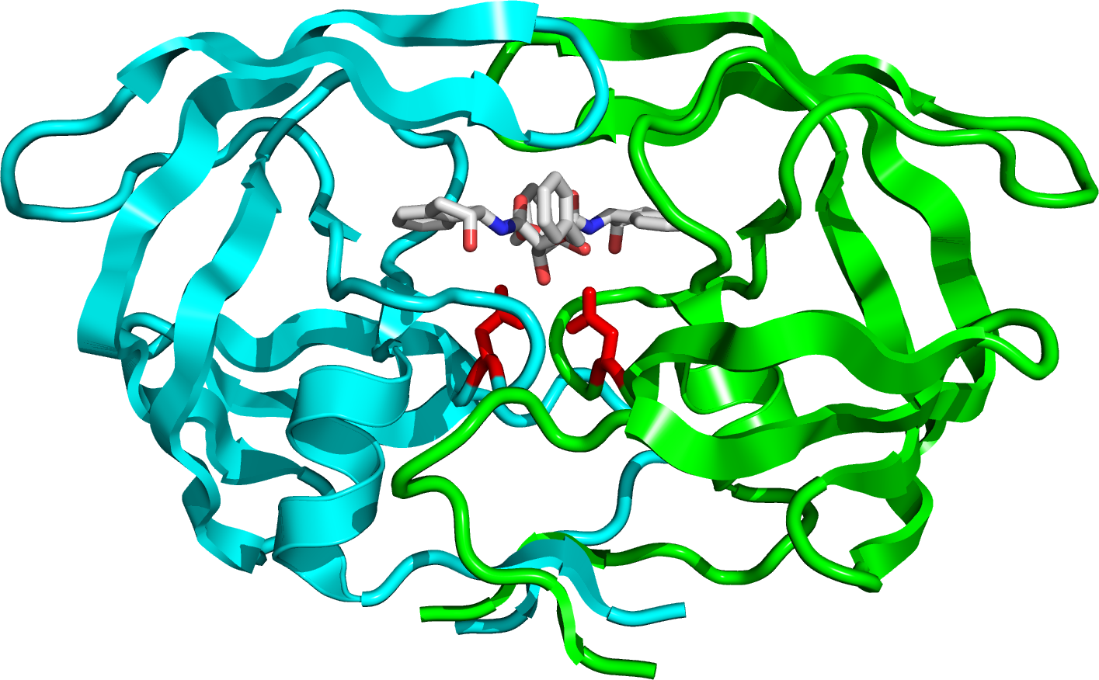
Where can improvements lie?
There are 4 basic types of intermolecular interactions we’re interested in:
Electrostatics
Induction
Dispersion
Exchange-repulsion
There’s a multitude of ways of representing each of these!
For biomolecular simulations, focus has been on improving electrostatics,
particularly induction, through polarisable force fields:
Polarisation of electron density in solvated Mannitol
Protein-protein interface of
Barnase/Barstar
HIV-1 protease active site
Fixed-charge force fields take account of polarisation implicitly,
but this does not allow for the effects of changes in environment

Slide 6
Where can improvements lie?
There are 4 basic types of intermolecular interactions we’re interested in:
Electrostatics
Induction
Dispersion
Exchange-repulsion
There’s a multitude of ways of representing each of these!
For biomolecular simulations, focus has been on improving electrostatics,
particularly induction, through polarisable force fields:
Fluctuating charge model
Drude oscillator model
Induced dipole model
q
q’
μ
q’
q
q
e.g. [old] CHARMM FlucQ ff
e.g. CHARMM Drude ff
e.g. AMOEBA

Slide 7
The AMOEBA model
AMOEBA = Atomic Multipole Optimised Energetics for Biomolecular Application
Harmonic term + additional anharmonic corrections

Slide 8
The AMOEBA model
AMOEBA = Atomic Multipole Optimised Energetics for Biomolecular Application
Urey-Bradley or stretch-bend terms for coupled bond-angle motion

Slide 9
The AMOEBA model
AMOEBA = Atomic Multipole Optimised Energetics for Biomolecular Application
Dihedral, out-of-plane, pi-torsion & torsion-torsion terms for coupled rotations & puckering in rings

Slide 10
The AMOEBA model
AMOEBA = Atomic Multipole Optimised Energetics for Biomolecular Application
Halgren’s buffered 14-7 potential

Slide 11
The AMOEBA model
Similar profiles at eqm. distances

Slide 12
The AMOEBA model
Softer repulsion at short distances

Slide 13
The AMOEBA model
AMOEBA = Atomic Multipole Optimised Energetics for Biomolecular Application
Atomic multipoles + induced dipoles
Iteratively solved until RMS change typically < 10⁻⁵ D

Slide 14
AMOEBA development
First water & ion models
P. Ren & J.W. Ponder, J. Phys. Chem. B, 2003, 107, 5933-5947
A. Grossfield, P. Ren & J.W. Ponder, J. Am. Chem. Soc., 2003, 125, 15671-15682
2002
Definition of polarisation model
P. Ren & J.W. Ponder, J. Comput. Chem., 2002, 23, 1497-1506
2003
Small organic molecules
P. Ren, C. Wu & J.W. Ponder, J. Chem. Theory Comput., 2011, 7, 3143-3161
2009
Further ion parameters, first protein/nucleic acid parameters
“amoebabio09.prm”
2011
Alternative water parameters
M.L. Laury et al., J. Phys. Chem B Theory Comput., 2015, 119(29), 9423-9437
2013
Revised protein parameters
Y. Shi et al., J. Chem. Theory Comput., 2013, 9, 4046-4063
For reviews & future directions see e.g.:
J.W. Ponder & D.A. Case, Adv. Prot. Chem., 66, 27-85
J.W. Ponder et al., J. Phys. Chem. B, 2010, 114(8), 2549-2564
A. Albaugh et al., J. Phys. Chem. B, 2016, 120(37), 9811-9832
2015

Slide 15
AMOEBA availability
Systems
Software packages
Proteins with standard amino acids
RNA/DNA with standard nucleic acids
(Some) simple organic molecules/solvents
Water
Many monovalent & divalent ions…
Tinker
AMBER
OpenMM
FFX (Mike Schnieders)
Tinker-HP (Jean-Philip Piquemal)
Today - Tinker only (but more on the others later)
Any questions?

Slide 16
Exercise 1 Getting started with Tinker

Slide 17
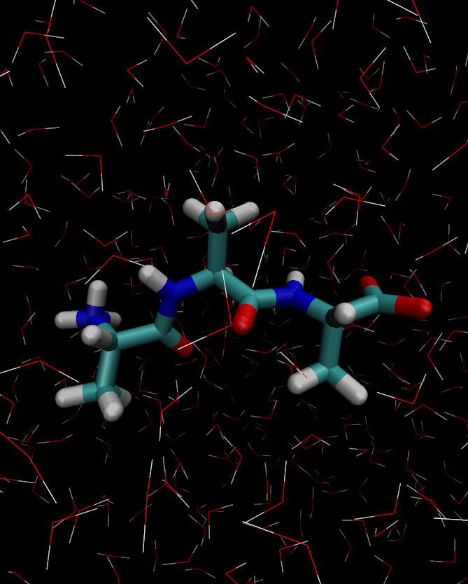
Exercise 1:
A few goals:
Become familiar with Tinker inputs, coordinate & parameter files
Become familiar with Tinker programs for setup, minimisation & molecular dynamics
Run some dynamics!
Get a feel for AMOEBA simulation speeds
Basic visualisation of Tinker files & trajectories (if there’s time)

Slide 18
Exercise 1 round up:
1) Tinker file formats:
*.xyz / *.arc
*.key
*.dyn
Contain atomic coordinates & topology. “Archive” (*.arc) files contain sequential frames of a trajectory in the same format
Contain simulation options & parameters (either directly or via a separate file included at the top of the *.key file)
Contain atomic positions, velocities & accelerations required for restarting a simulation. Automatically used if a *.dyn file exists with the same prefix as the *.xyz
2) Tinker programs
pdbxyz
minimize
dynamic
Converts a PDB format file to an Tinker xyz format. Can recognise standard amino acid names and assign atom types if given suitable force field
Minimises a given structure using the options set in a key file (see also optimize/newton for other minimisation algorithms)
Main MD engine, performs simulation using options specified in key file, and in choice of NVE/NVT/NPT ensemble

Slide 19
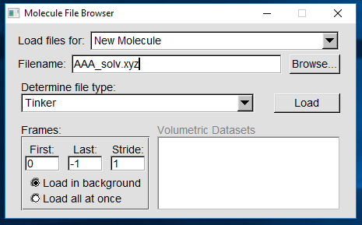
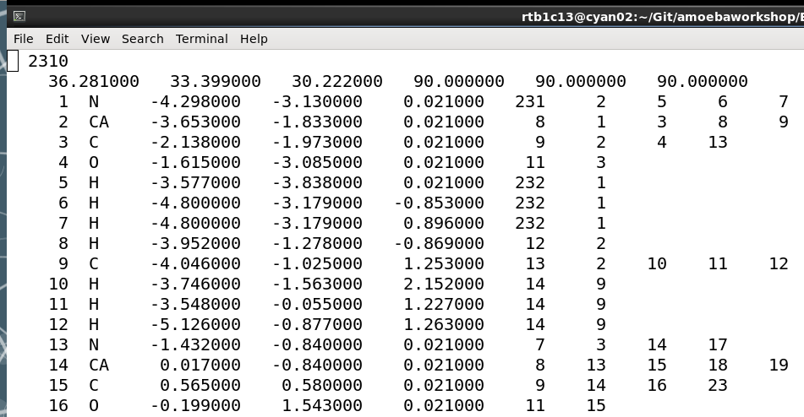
Exercise 1 round up:
3) AMOEBA simulation speed
This is a small system (2310 atoms) and we use only 8 CPU cores. Takes around 8 mins for 5 ps of simulation
0.9 ns/day with a 1 fs timestep
= significantly slower than an equivalent fixed-charge simulation on CPUs
4) Visualisation
Two things to remember:
‘Tinker’ file type
NO periodic box info (yet!)
Any questions?

Slide 20
Exercise 2 What if I have a ligand?

Slide 21
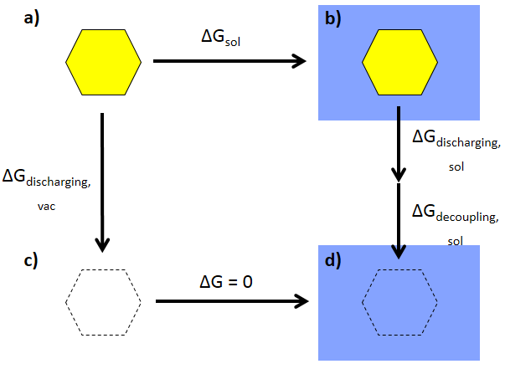
Exercise 2:
A solvation free energy thermodynamic cycle:
Property of interest
Steps stratified into intermediate λ windows
How do we parameterise the solute we want to investigate?

Slide 22
Exercise 2:
Overall AMOEBA parameterisation process:¹
Valence, vdW, polarisability assignments
Torsional scanning
Final multipoles & valence parameters
Initial structure
Geometry optimisation
ESP calculation
ESP fitting
Distributed Multipole Analysis
Initial multipoles
¹ P. Ren, C. Wu & J.W. Ponder, J. Chem. Theory Comput., 2011, 7, 3143-3161

Slide 23
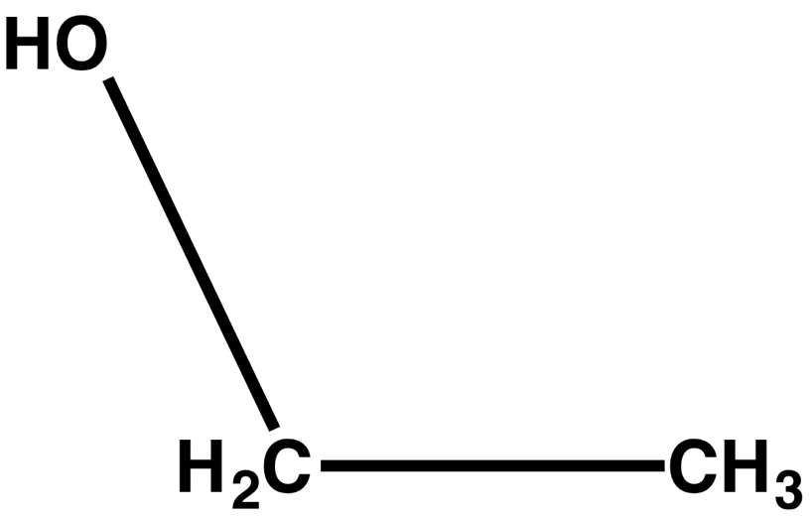
Exercise 2:
A few goals:
Parameterise ethanol consistently with the rest of the force field
Become familiar with AMOEBA treatment of permanent & induced electrostatics (local frames, polarisation groups, Thole polarisabilities…)
Get a feel for how valence parameters can be assigned and fitted
Do some basic testing of your assigned parameters through simulation
Set up for some free energy calculations
N.B. Exercise 2 is split into two halves, but you can arrange these before/after lunch as you wish

Slide 24
Exercise 2 round up:
Parameterisation is lengthier than a fixed-point-charge model
BUT
There is a well-defined process to follow!

Slide 25
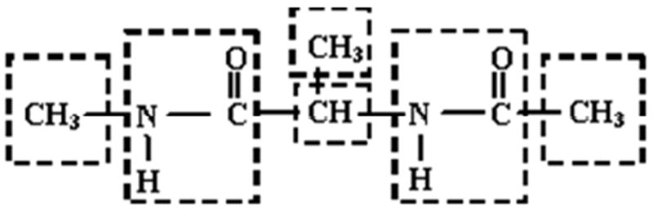
Exercise 2 round up:
1) Another look at the electrostatics terms:
Any ‘permanent multipoles’ derived from QM calculations
will include a contribution from intramolecular polarisation
In MM, AMOEBA induced dipole model contributes this intramolecular term, and permanent multipoles should be conformation independent
How does AMOEBA treat intramolecular polarisation? Through ‘polarisation groups’:
Polarisation groups in alanine

Slide 26
Exercise 2 round up:
1) Another look at the electrostatics terms:
What happens to induced point dipoles at very short range?
Induced dipoles feel the external field E, plus the response field due to the adjacent dipole
As inter-dipole distance decreases, the response field -> ∞
μ_{ind}
μ_{ind}
E
Known as the ‘polarisation catastrophe’

Slide 27
Exercise 2 round up:
1) Another look at the electrostatics terms:
Known as the ‘polarisation catastrophe’
AMOEBA uses a Thole damped polarisation model¹ to avoid this, replacing point multipoles with smeared distributions, e.g.:
Where:
Both the ‘damping parameter’ a and the polarisabilities α can be empirically chosen to work with this model. For AMOEBA, a = 0.39, and α are based on the original values suggested by Thole¹, with minor adaptations (see e.g. the review papers earlier)
¹ B.T. Thole, Chem. Phys., 1981, 59, 341-350

Slide 28
Exercise 2 round up:
2) Valence parameters
…can be suggested based on atom type by valence and/or fitted to QM data using valence or torsfit. What will work best for you will depend on your molecule!
3) Control of free energy calculations
λ value(s) for alchemical free energy calculations controlled by keywords in key file:
ligand -1 9 defines atoms to be mutated (either range or list)
vdw-lambda 1.0 defines coupling of ligand vdW interactions to surrounding system (1.0 = on, 0.0 = off)
ele-lambda 1.0 defines scaling of ligand multipoles/polarisabilities (1.0 = on, 0.0 = off)
(Note that electrostatic interactions are annihilated, while vdW interactions are decoupled, with softcore potentials by default - this will affect the legs needed in your thermodynamic cycle)
Any questions?

Slide 29
Exercise 3 Free energy calculation & analysis

Slide 30
Exercise 3:
We’ve provided some example data of:
Solution phase discharging of electrostatics,
11 windows from λ = 1.0
to λ = 0.0
Gas phase discharging of electrostatics,
11 windows from λ = 1.0
to λ = 0.0
Solution phase decoupling of vdW,
11 windows from λ = 1.0
to λ = 0.0
Overall: ∆G_{sol} = ∆G_{discharging,vac} - ∆G_{decoupling,sol} - ∆G_{discharging,sol}
But how do we calculate free energies for individual legs from the trajectories?

Slide 31
Exercise 3:
Alchemical free energy calculations (for some, these will be familiar…)
1) Zwanzig, FEP, Exponential Averaging…(choose your favourite name!)
Relating free energy back to the configurational partition function
. . .
2) Bennett’s Acceptance Ratio (BAR)
Too long to derive here, but see e.g. alchemistry.org
where:
Given a set of atomic coordinates over time (an ensemble averages of structures), we can calculate free energy differences between neighbouring states with different Hamiltonians (potential energy functions)

Slide 32
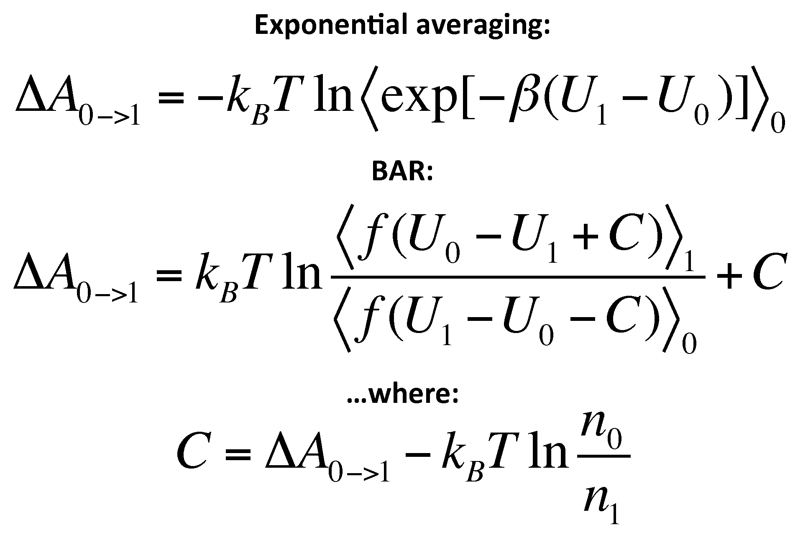
Exercise 3:
A few goals:
Become familiar with basic use of analyze to analyse trajectories
Run EA and BAR calculations on example trajectories
Get a feel for the sensitivity of EA by comparing forward/backward ∆G, simulation length etc. (if there’s time)

Slide 33
Exercise 3 round up:
1) Free energies with AMOEBA
The BAR ∆G_{hyd} for ethanol using the trajectories here = 6.1 kcal mol⁻¹
Could conceivably be improved with e.g.:
Longer simulations
Greater initial equilibration
Empirical scaling of hydroxyl quadrupoles¹
For other examples of AMOEBA free energy calculations, see e.g. refs. 1-4 below
2) Other analyses with AMOEBA
Tinker includes a range of analysis programs but the real power comes from alternative software packages (MDTraj, Parmed, cpptraj…)
¹ Y. Shi et al., J. Comput. Chem., 2011, 32(5), 967-977
² R.T. Bradshaw & J.W. Essex, J. Chem. Theory Comput., 2016, 12(8), 3871-3883
³ N.A. Mohamed, R.T. Bradshaw & J.W. Essex, J. Comput. Chem., 2016, 37(32), 2749-2758
⁴ D. Jiao et al., Proc. Nat. Acad. Sci. USA, 2008, 105(17), 6290-6295

Slide 34

Exercise 3 round up:
3) Other AMOEBA applications
GPUs are the way forward!
As of Tinker 7, dynamic can take advantage of GPU hardware using a Tinker-OpenMM plugin
AMOEBA protein force field is also available in the standalone OpenMM package
GPU hardware can access between 5-20 ns/day of simulation on solvated protein systems (20-25k atoms)
Current applications using OpenMM include electric field calculations…TBC!
Any questions?

Slide 35
Research roundup
Prof. Jon Essex, University of Southampton

